Slide 1

Ddaprogrameba HASKELL enaze
Tavi 1 - Sesavali

Slide 2
Pprogramuli uzrunvelyofis krizisi
rogor gavarTvaT Tavi Tanamedrove kompiute-rul programaTa zomasa da sirTules?
rogor SegviZlia programaTa damuSavebis dro-isa da Rirebulebis Semcireba?
rogor SegviZlia gavzardoT Cveni rwmena, rom programebi koreqtulad daasrulebs muSaobas?

Slide 3
Ddaprogramebis enebi
erT-erT gamosavals programuli uzrunvelyo-fis krizisidan warmoadgens daprogramebis axali enebis Seqmna:
SevecadoT programaTa dawera mkafiod, lakonurad da abstraqciis maRal doneze;
programuli uzrunvelyofis mravaljeradi gamoyenebis komponenentebs upiratesoba mivceT;
wavaxalisoT formaluri Semowmebis gamoyeneba;

Slide 4

uzrunvelvyoT swrafi prototipirebis SesaZlebloba;
uzrunvelvyoT amocanaTa gadawyvetis mZlavri saSuale-bebi.
funqcionaluri enebi am miznebis misaRwevad gansakuTrebu-lad elegantur saSualebebs gvaZlevs !!!

Slide 5
ra aris funqcionaluri daprogrameba?
arsebobs sxvadasxva azri da Znelia zusti gansazRvra, magram zogadad SeiZleba iTqvas:
funqcionaluri daprogrameba _ daprogramebis stilia, romelSic gamoTvlaTa mTavari meTodia argumentebad warmodgenili funqciebis gamoyeneba;
funqcionaluri ena – es iseTi enaa, romelic axorcie-lebs daprogramebis funqcionalur stils da xels uwyobs mas.

Slide 6
magaliTi
1-dan 10-mde mTeli ricxvebis Sekreba Java-ze
total = 0;
for (i = 1; i ≤ 10; ++i)
total = total+i;
gamoTvlis meTodia cvladisaTvis mniSvnelobis miniWeba

Slide 7
magaliTi
1-dan 10-mde mTeli ricxvebis Sekreba Haskell-ze
sum [1..10]
gamoTvlis meTodia funqciis gamoyeneba

Slide 8
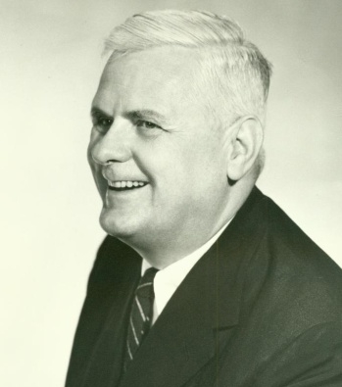
istoriuli mimoxilva
1930 weli:
alonzo CerCi qmnis lambda-aRricxvas _ funqciaTa martiv, magram mZlavr Teorias.

Slide 9
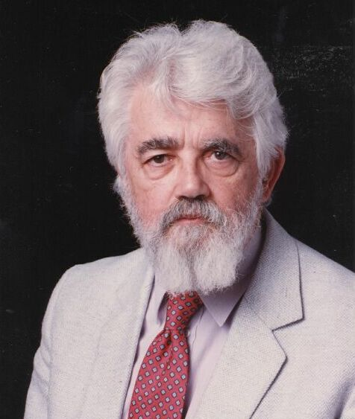
istoriuli mimoxilva
1950 weli:
jon mak-karti qmnis pirvel funqciona-lur Lisp enas lambda-aRricxvis garkveu-li zegavleniT, magram cvladisaTvis mni-SvnelobaTa miniWebis SenarCunebiT.

Slide 10
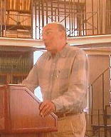
istoriuli mimoxilva
1960 weli:
piter lendini qmnis pirvel wminda funqci-onalur ISWIM enas lambda-aRricxvis mkacr safuZvelze da cvladisaTvis mniSvnelobis miniWebis gamouyeneblad.

Slide 11

istoriuli mimoxilva
1970 weli:
bekusi aviTarebs funqcionalur enaze warmodgenebs, Semoaqvs maRali rigis funqciaTa cneba da ayalibebs azrebs programebze aseTi enis gamoyenebisas.

Slide 12
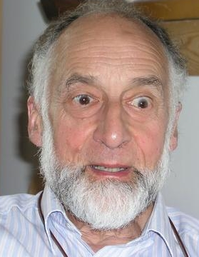
istoriuli mimoxilva
1970 weli:
robin milneri da sxvebi qmnian ML enas – pirvel Tanamedrove funqcionalur enas, romelSic warmodgenilia tipis gamoyvana da polimorfuli tipebi.

Slide 13

istoriuli mimoxilva
1970 – 1980 wlebi:
devid terneri qmnis rig zarmac funqcio-nalur enas, romlebic agvirgvinebs Miranda sistemas.

Slide 14

istoriuli mimoxilva
1987 weli:
kvlevaTa saerTaSoriso komiteti standartuli zarmaci Haskell funq-cionaluri enis Seqmnis inicirebas axdens.

Slide 15
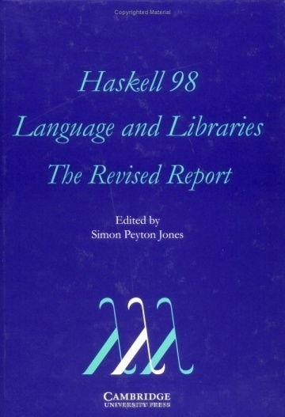
istoriuli mimoxilva
2003 weli:
komiteti aqveynebs Haskell 98 angariSs, romel-mac enis stabiluri versia gansazRvra.

Slide 16
სიის სწრაფი დახარისხება
f [] = []
f (x:xs) = f ys ++ [x] ++ f zs
where
ys = [a | a ← xs, a ≤ x]
zs = [b | b ← xs, b > x]
?

